Slide 1

L12 – Gadget Shop
C273 – Advanced Web Applications Development in PHP

Slide 2
Today's problem
Integrate a payment gateway to existing shopping cart application

Slide 3
What is the 4 payment gateways?
A payment gateway is a software program integrated to a merchant's website to transmit transaction data to acquirer for authorization and settlement:
Credit Card
Net Banking
Cash Card
Mobile Payment

Slide 4
Paypal
PayPal is an online payment service founded in 1998 and owned by eBay.
It facilitates the transfer of money from one party to another over the internet.
Payments can be made for goods, services, and online donations can be made as well.

Slide 5
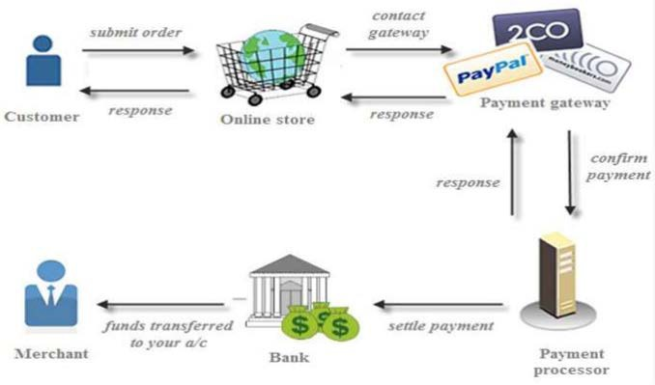
How PayPal works

Slide 6
PayPal Express Checkout
PayPal’s Express Checkout lets your customers pay quickly and conveniently.
With PayPal Express Checkout, your customers get the fastest, most streamlined PayPal checkout experience.
Your customers select items to purchase and proceed to check out. When your customers choose to pay with PayPal, they are securely transferred to PayPal.
Your customers also have the option of using your
existing checkout for credit card payments.

Slide 7
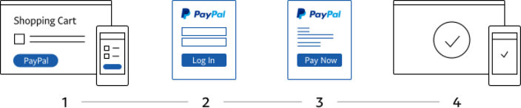
How PayPal Express Checkout works
PayPal website
Your website
Your website
Customer chooses to checkout
Customer confirms stored shipping and billing info
Customer views order confirmation

Slide 8
PayPal Express Checkout
Step 1: add the checkout.js script
Step 2:Create a container for the button
Step 3:Write code to render paypal button

Slide 9
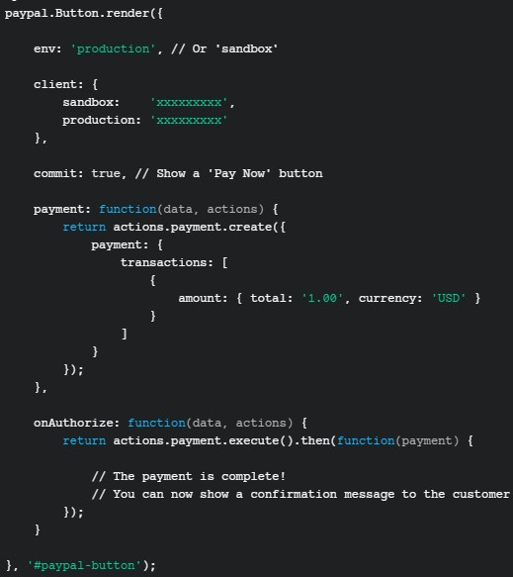
PayPal Express Checkout
Create payment information here
Show confirmation message here

Slide 10
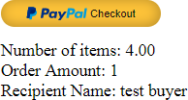
Displaying confirmation message
In the onAuthorize call back, show a confirmation page.
Use the payment and buyer details from actions.payment.execute()
….
onAuthorize: function (data, actions) {
return actions.payment.execute().then(function (response) { var message = "";
message += "Number of items: " + response.transactions[0].amount.total + "<br/>"; message += "Order Amount: " + response.transactions[0].item_list.items.length + "<br/>";
message += "Recipient Name: " + response.payer.payer_info.shipping_address.recipient_name;
$("#results").html(message);
});
}

Slide 11
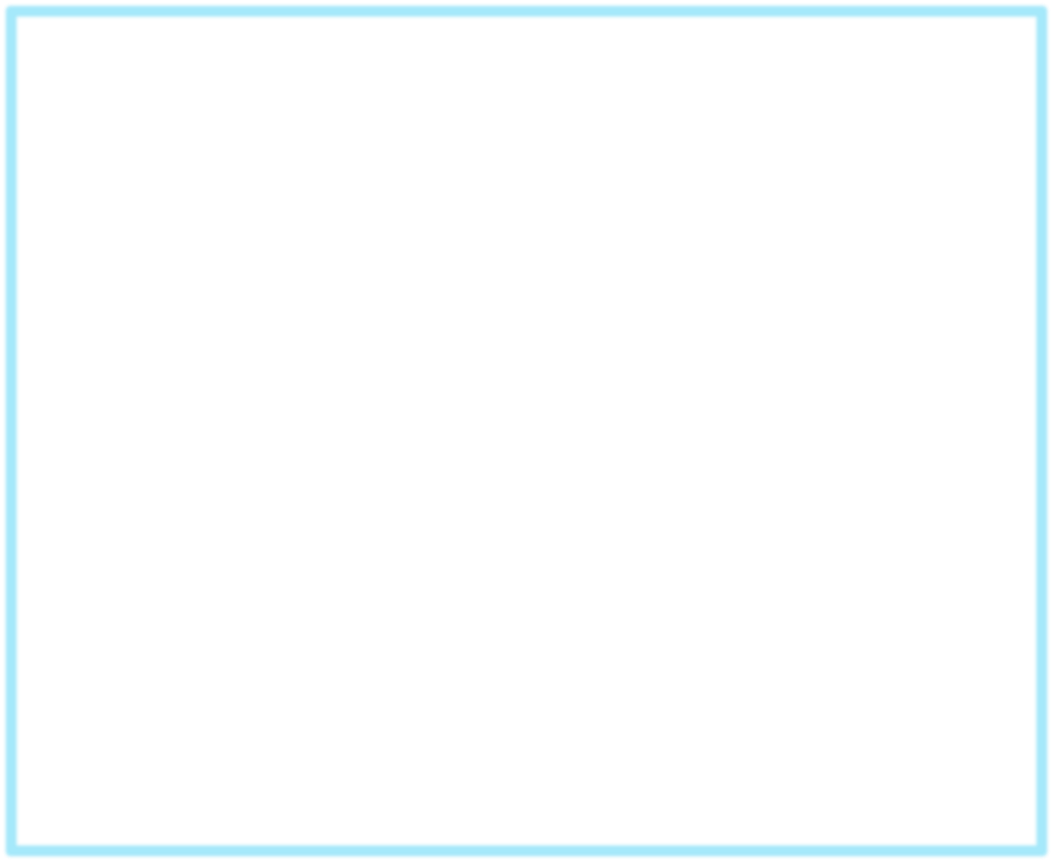


manageGadgetShop.js
var currency = 'USD';
$(document).ready(function () {
$(".btn").click(function() { var id = $(this).val();
$.ajax({
url: "getItemDetails.php", data: "id=" + id,
type: "GET", cache: false, dataType: "JSON",
success: function (data) {
$('[name=itemname]').val(data.name);
$('[name=itemprice]').val(data.price);
Show the modal when the “Buy” button is clicked
$('#item_modal').modal('show');
},
error: function (obj, textStatus, errorThrown) { console.log("Error " + textStatus + ": " + errorThrown);
}
});
});

Slide 12



manageGadgetShop.js
Display the paypal button
paypal.Button.render({ env: 'sandbox', client: {
sandbox: ‘xxxxxxx'
},
commit: true,
payment: function (data, actions) { var payment = setupPayment();
return actions.payment.create(payment);
},
onAuthorize: function (data, actions) {
return actions.payment.execute().then(function (response) { showConfirmation(response)
$("#item_modal").modal("hide");
});
}
}, '#paypal-button');

Slide 13



manageGadgetShop.js – setupPayment()
function setupPayment() { var total = 0;
var itemList = [];
var itemName = $("[name=itemname]").val(); var itemPrice = $("[name=itemprice]").val(); var itemQty = $("[name=itemqty]").val();
var item = {name: itemName, description: '', quantity: itemQty, price: itemPrice, currency: currency};
itemList.push(item);
total = parseFloat(itemPrice) * parseInt(itemQty); var payment = {
Add item object into a list
payment: { transactions: [
{
amount: {total: total, currency: currency},
Total up the item price and quantity
Create payment object
item_list: {items: itemList}
}
]
}
}
return payment;
}//end setUpPayment

Slide 14



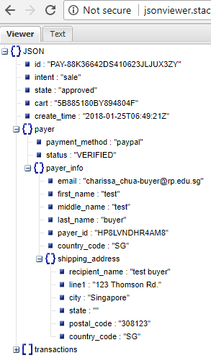
manageGadgetShop.js – showConfirmation()
function showConfirmation(response) {
var shipping = response.payer.payer_info.shipping_address; var item = response.transactions[0].item_list.items[0];
var message = "Your item <b>" + item.name + "</b> will be shipped to:<br/>"
+ shipping.recipient_name + "<br/>"
+ shipping.line1 + "<br/>"
+ shipping.postal_code + " "
+ shipping.country_code + "<br/><br/>";
$("#msg").html(message);
}

Slide 15
What you learnt today
Setup PayPal Sandbox Account
Demonstrate understanding of the checkout process workflow
Implement Express Checkout using Payments API

